Slide 1
Lecture 2: Components of Information Retrieval
17/01/2023

Slide 2
COMPONENTS OF INFORMATION RETRIEVAL

Slide 3
Revise IR
Information retrieval is concerned with representing, searching, and manipulating large collections of electronic text and other human-language data.

Slide 4
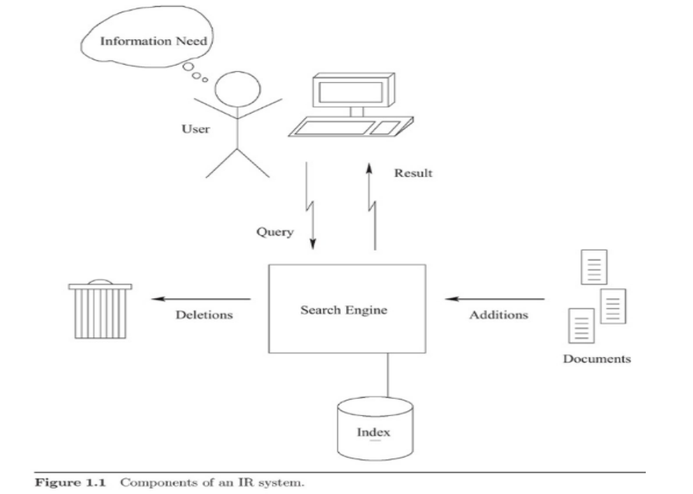
Basic IR System Architecture

Slide 5
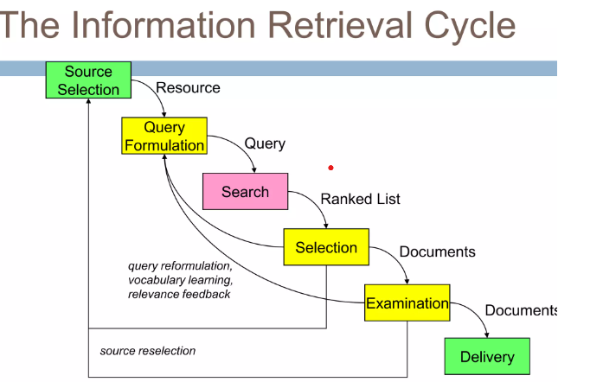

Slide 6
Before conducting a search
Before conducting a search, a user has an information need, which underlies and drives the search process.
This information need is sometimes referred as a topic, particularly when it is presented in written form as part of a text collection for IR evaluation.
As a result of the information need, the user constructs and issues a query to the IR system.
This query consists of a smaller number of terms, with two or three terms being typical for a Web search.
Depending on the information need, a query term may be a date, a number, a musical note, or a phrase.
Wildcard operators and other partialmatch operators may also be permitted in query terms.
For example, the term “inform*” might match any word starting with that prefix (“inform”, “informs”, “informal”, “informant”, informative”, etc.).

Slide 7
What User Interface holds?
Although users typically issue simple keyword queries, IR systems often support a richer query syntax, frequently with complex Boolean and pattern matching operators.
These facilities may be used to limit a search to a particular Web site, to specify constraints on fields such as author and title, or to apply other filters, restricting the search to a subset of the collection.
A user interface mediates between the user and the IR system, simplifying the query creation process when these richer query facilities are required.

Slide 8
Query and Search Engine
The user’s query is processed by a search engine, which may be running on the user’s local machine, on a large cluster of machines in a remote geographic location, or anywhere in between.
A major task of a search engine is to maintain and manipulate an inverted index for a document collection.
This index forms the principal data structure used by the engine for searching and relevance ranking.
As its basic function, an inverted index provides a mapping between terms and the locations in the collection in which they occur.

Slide 9
Relevance Ranking Algorithms
To support relevance ranking algorithms, the search engine maintains collection statistics associated with the index, such as the number of documents containing each term and the length of each document.
In addition the search engine usually has access to the original content of the documents in order to report meaningful results back to the user.

Slide 10
Process of Ranking
Using the inverted index, collection statistics, and other data, the search engine accepts queries from its users, processes these queries, and returns ranked lists of results.
To perform relevance ranking, the search engine computes a score, sometimes called a retrieval status value (RSV), for each document.
After sorting documents according to their scores, the result list must be subjected to further processing, such as the removal of duplicate or redundant results.

Slide 11
Example
a Web search engine might report only one or results from a single host or domain, eliminating the others in favor of pages from different sources.

Slide 12
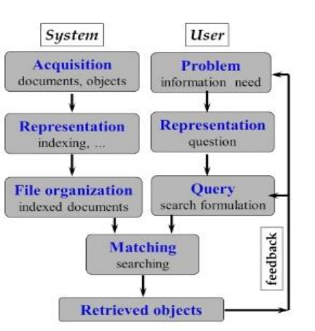
Traditional IRS
Three major components of Traditional IRS
1. Document subsystem
a) Acquisition
b) Representation
c) File organization
2. User sub system
a) Problem
b) Representation
c) Query
3. Searching /Retrieval subsystem
a) Matching
b) Retrieved objects

Slide 13
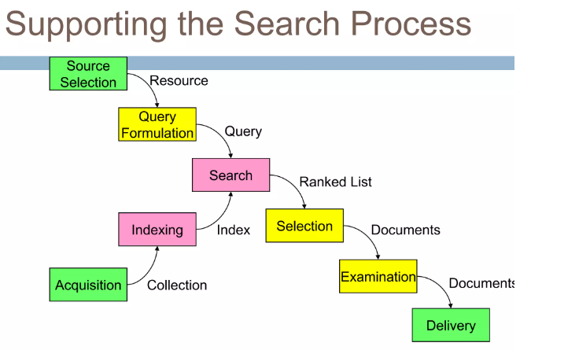

Slide 14
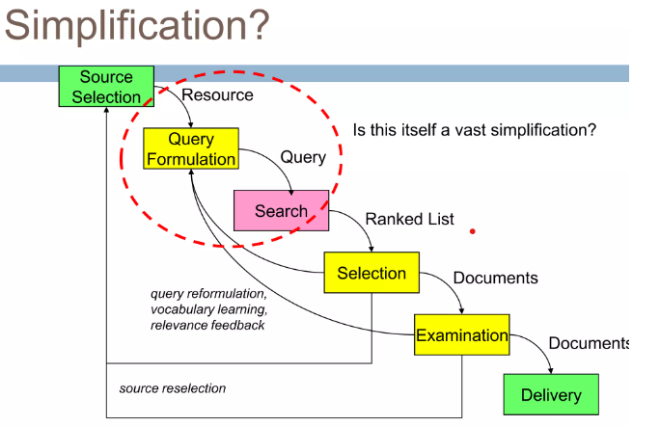

Slide 15
Major Components IR Systems
An information retrieval system thus has three major components
the document subsystem,
the users subsystem,
and the searching/retrieval subsystem.

Slide 16
Functions of IR
These divisions are quite broad and each one is designed to serve one or more functions, such as:
• Analysis of documents and organization of information (creation of a document database)
• Analysis of user’s queries, preparation of a strategy to search the database
• Actual searching or matching of users queries with the database, and finally
• Retrieval of items that fully or partially match the search statement.

Slide 17
Acquisition (Document subsystem)
Selection of documents & other objects from various web resources.
Mostly text based documents
o full texts, titles, abstracts...
o but also other objects:
▪ data, statistics, images, maps, trade marks, sounds ...
• The data are collected by web crawler and stored in data base.

Slide 18
Representation of documents, objects(document subsystem)
• Indexing – many ways :
free text terms (even in full texts)
controlled vocabulary - thesaurus
manual& automatic techniques.
• Abstracting; summarizing c
• Bibliographic description:
author, title, sources, date…
metadata
• Classifying, clustering
• Organizing in fields & limits
Basic Index, Additional Index and Limitss

Slide 19
File organization (Document subsystem)
Sequential
record (document) by record
Inverted
term by term; list of records under each term
Combination
indexes inverted, documents sequential
When citation retrieved only, need for document files
Large file approaches
for efficient retrieval by computers

